Slide 1

A whole new way to
har
c
ge.

Slide 2


Slide 3
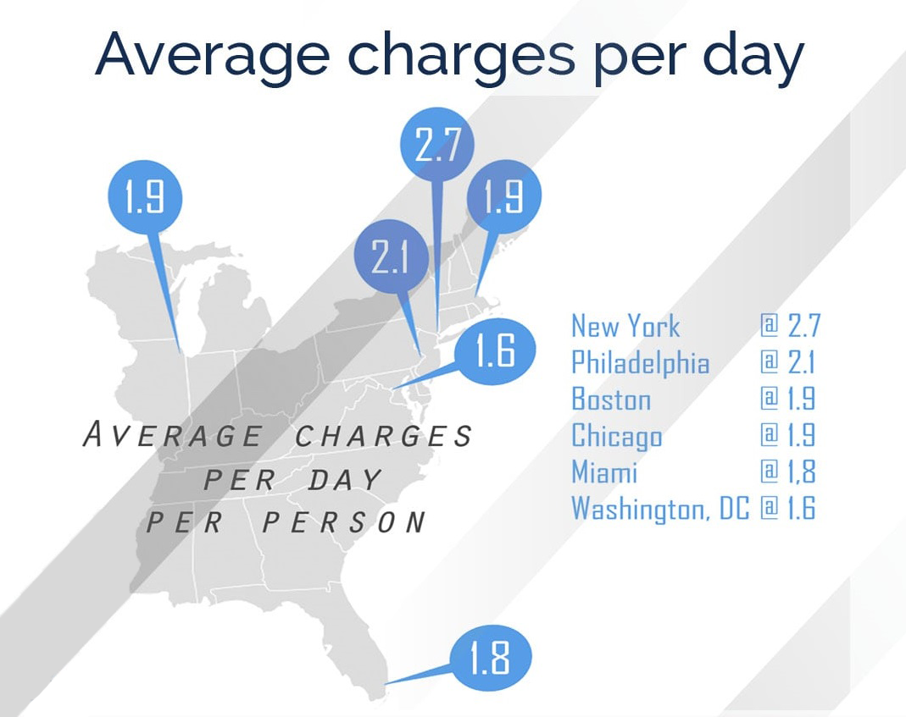

Slide 4

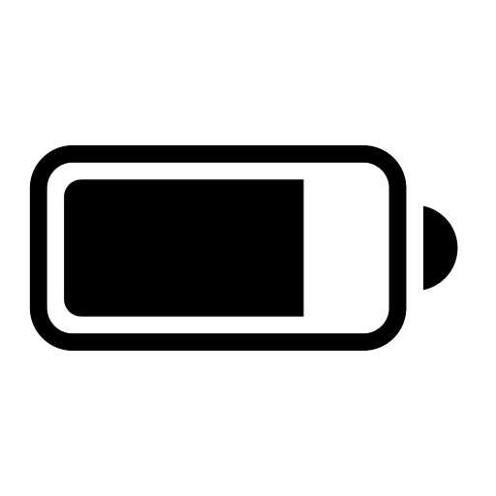
250 cycles
~73% battery

Slide 5
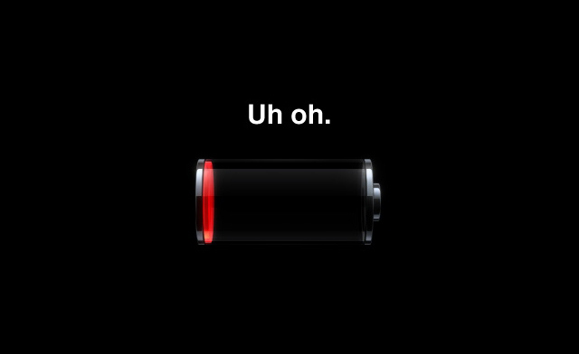

Slide 6

7.7 out of 10
Report low battery anxiety,
BUT
72%
Carry no backup
18%
Carry a charging cable
10%
Carry a portable charger

Slide 7
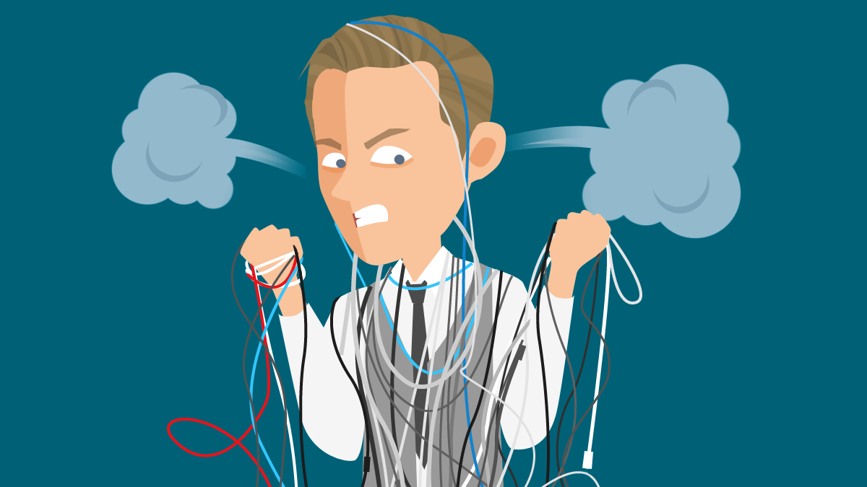
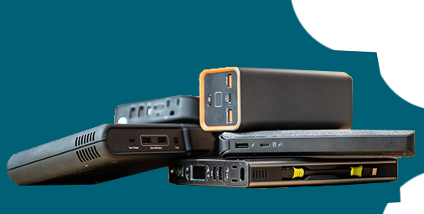
The Problem?

Slide 8
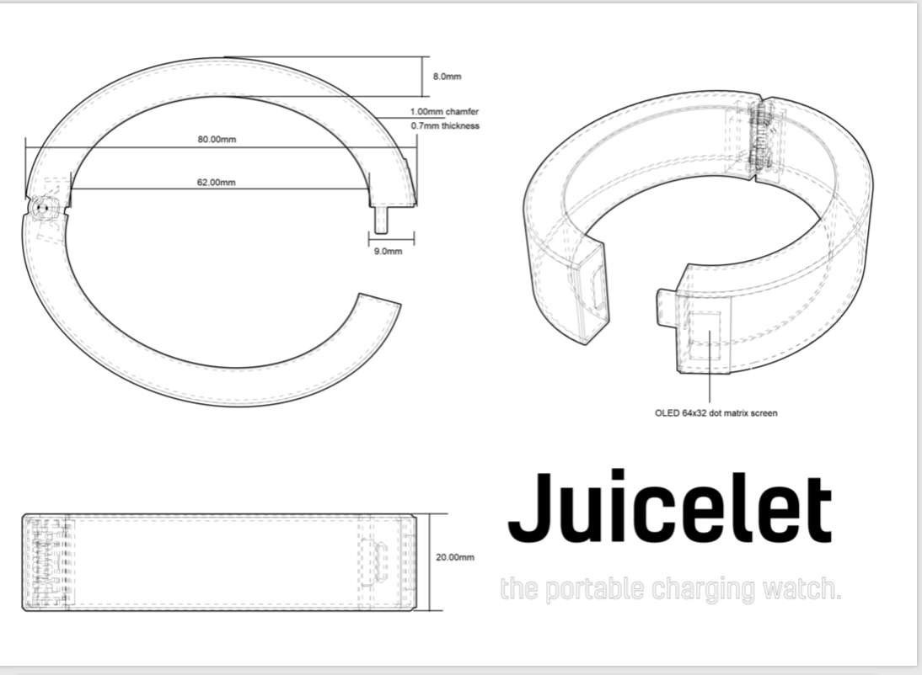


The worlds first-ever portable charging watch.

Slide 9
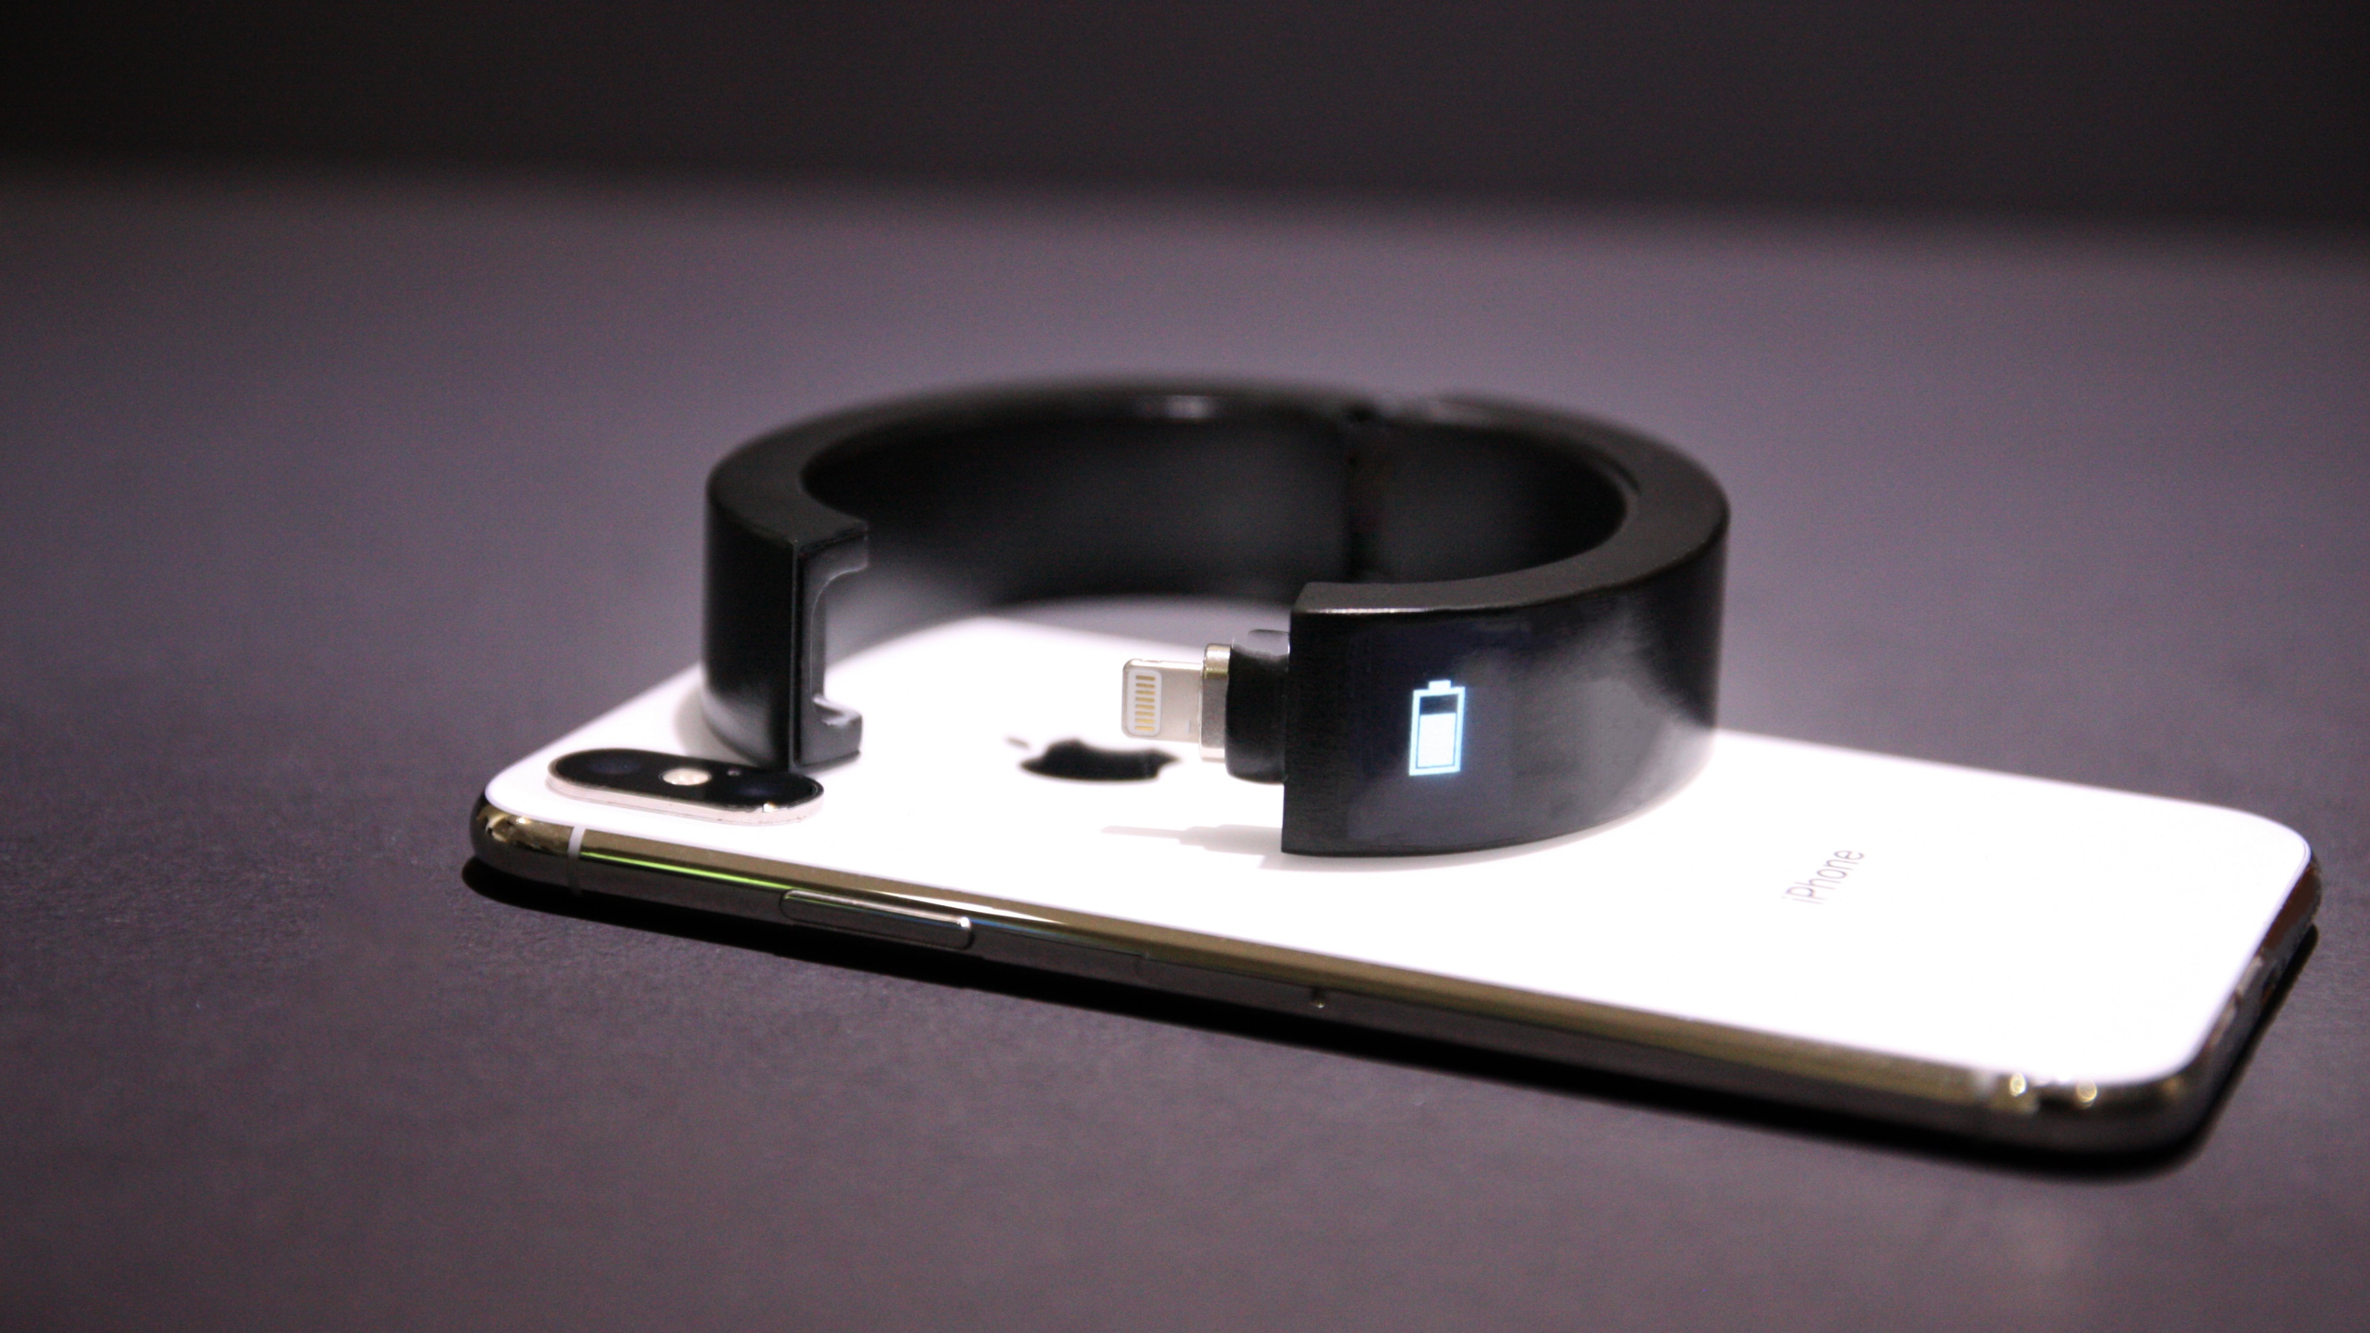
Simplicity meets functionality.
Full charge on over 80% of smartphones

Slide 10
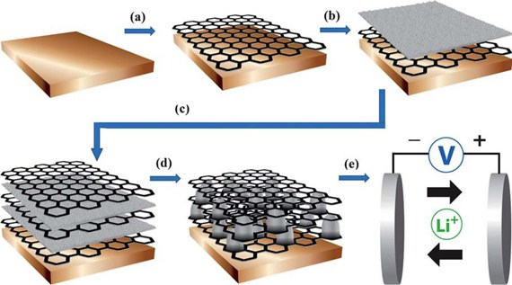
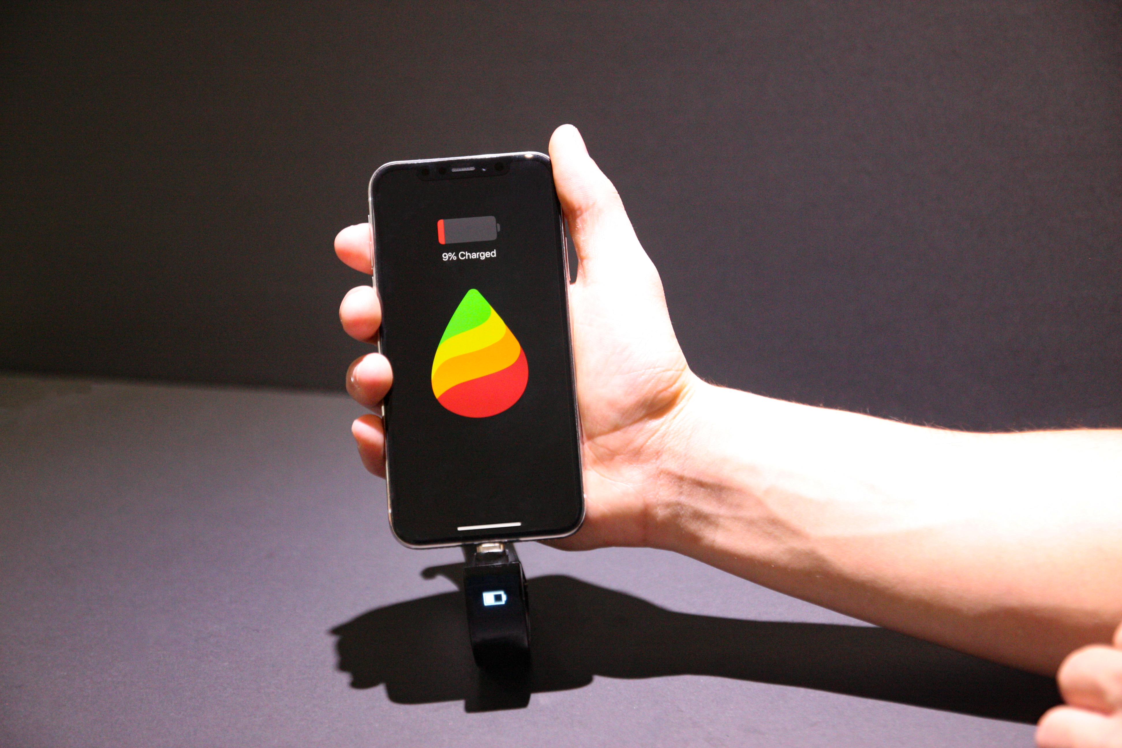
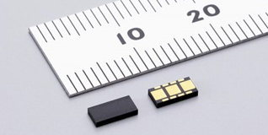

A new way to charge
Graphene-enhanced battery
Android/iPhone system
Smart OLED display
MEMS MicroSensors
Ergonomic hinge design

Slide 11








Brian Periku
Shahkir Alkozai
Liam Graham
Unmatched passion, talent, and industry skills

Slide 12

Redefining portable charging.

